Slide 1
CS2107 Tutorial 1
T[03/08]
Goh Rui Zhi
gohruizhi@u.nus.edu

Slide 2
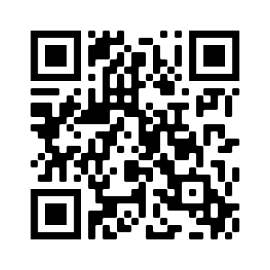
T8 Telegram group
https://t.me/joinchat/5999VUrhkKs2ZDE1

Slide 3
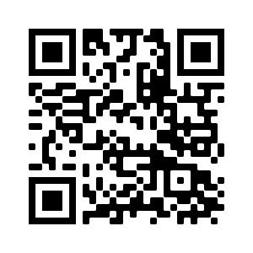
T3 Telegram group
https://t.me/joinchat/zDlZtHGKdnM1NDg1

Slide 4
About me
Year 4 Computer Science Student
Currently taking: CS4248 (NLP) , CS3219 (SWE Principles and Patterns), CP4101(FYP)
Telegram: @Ruizhiii
Email: gohruizhi@u.nus.edu

Slide 5
Admin
Attendance is graded (5%) (Only 5/9 tutorials + 1 Presentation required)
Can’t attend tutorial (but still want to come) – Let me know, I will look for another slot for you.
Important: Join with your NUS email zoom account (for accountability)
** Avoid sharing tutorial zoom links

Slide 6
MOReeee Adminnnn
Tutorial solutions will be released
Slides will released too (Telegram group or Email)
Ask questions in Telegram group (try to avoid PMing me, unless personal)
Telegram group as main form of communication (any objections?)

Slide 7
Schedule
3. Intro, Encryption
4. Password, 2FA
5. Authenticity: birthday attacks, hash
6. PKI, PKI attacks
7. Mid-term revision
8. Mid-term quiz discussion
9. Renegotiation attack
10. Network security
11. Secure programming

Slide 8
About CS2107
Useful foundations: CS2105 (Networks), CS2106 (Operating Systems)
Web Security (understanding web protocols)
Secure Programming (understanding computer memory)
Useful BUT NOT NEEDED
EASY MODULE
Content
Quiz
Exams
Hardest Part: Assignments!!!!

Slide 9
Tutorial Questions

Slide 10
Question 1
Alice was the Web administrator of the company WhatSecurity*. A malicious attacker sent an email to Alice. The email instructed Alice to click on a link so as to login to the company’s HR system to view a report. In the email, information of the “sender” had been modified to be the HR manager of WhatSecurity. Alice wrongly believed that the email was indeed sent by the manager, and followed the instructions. In doing so, she revealed her password to the attacker. Using Alice’s password, the attacker then logged-in to the Web server, and invoked many processes. As a result, the server got overloaded.
With respect to the security requirements mentioned in the lecture (confidentiality, integrity, availability, authenticity, etc.), discuss what aspects of security were compromised.

Slide 11
Question 1 - ReCAP
Confidentiality: Assurance that asset is viewed only by authorised parties
Integrity: Assurance that asset is modified only by authorised parties
Availability: Assurance that asset is available to any authorised party at any time
Authenticity: Assurance that asset is from the source it claims to be

Slide 12
Question 1
Confidentiality compromised: Password revealed, Web server accessed
Integrity compromised: Email (sender address, content) modified, Adversary may modify web server after login
Availability compromised: Server unavailable (overloaded), Adversary may change password and prevent access to asset by authorised party
Authenticity compromised:
1. Adversary was not HR manager (Alice’s Perspective)
2. Web link was fraudulent (Alice’s Perspective)
3. Adversary was not Alice (Webserver’s Perspective)

Slide 13
Question 1- Bonus
Accountability/ Non-repudiation: Assurance that user cannot deny involvement
Auditability: Assurance that all actions related to given asset can be traced

Slide 14
Question 2
Suppose it takes 512 clock cycles to test whether a 64-bit cryptographic key is correct, when given a 64-bit plaintext and its corresponding ciphertext.
How long does it take to exhaustively check all the keys using a 4GHz (single-core) processor?
How long does it take on a cluster of 1024 servers, each with a quadcore 4Ghz processor
(Hint: For simplicity, you can take 1 year ≈ 2^25 seconds. Also note that: 1K = 2^10, 1M = 2^20, 1G = 2^30.)

Slide 15
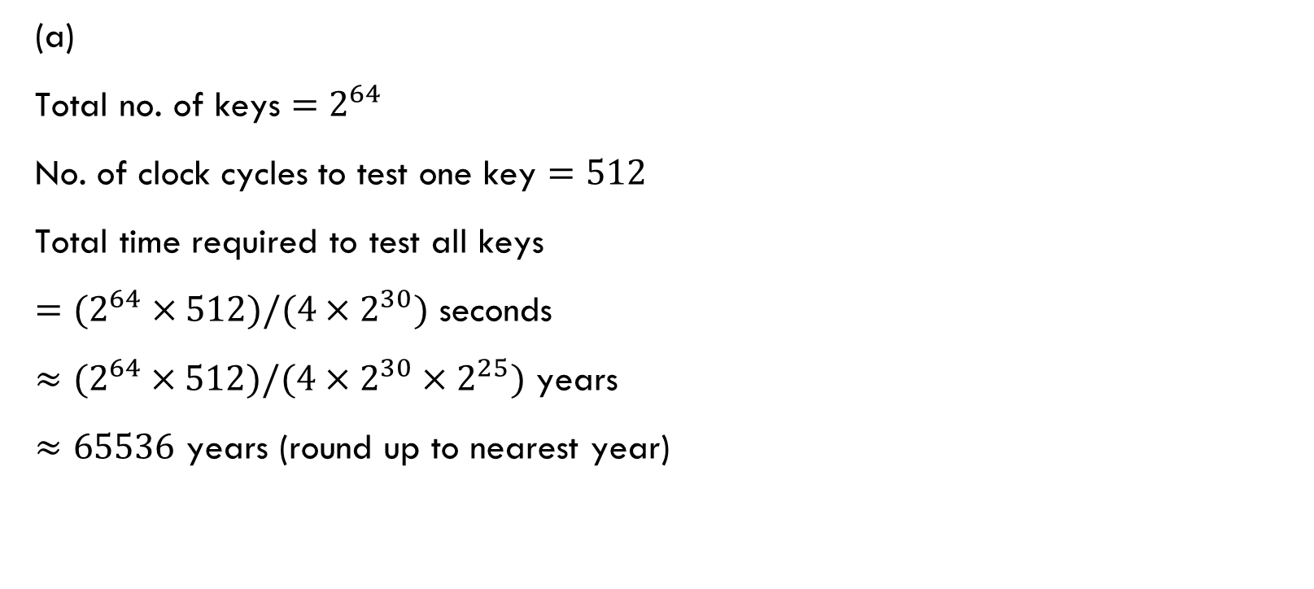
Question 2
(a)
Total no. of keys ${=2}^{64}$
No. of clock cycles to test one key $=512$
Total time required to test all keys
${=(2}^{64} ×512)/(4×2^{30})$ seconds
${≈(2}^{64} ×512)/(4×2^{30}×2^{25})$ years
$≈65536$ years (round up to nearest year)

Slide 16

Question 2
(b)
Total time required to test all keys
${=(2}^{64} ×512)/(4×2^{30})$ seconds
${=(2}^{64} ×512)/(4×2^{30}×2^{25}×1024×4)$ years
$≈16$ years (round up to nearest year)
Alternate method:
We now have 4 × 1024 cores instead of 1. Divide answer from (a) with this will get same answer.

Slide 17
Question 3
Suppose it takes 512 clock cycles to test whether a 32-bit cryptographic key is correct, when given a 32-bit plaintext and its corresponding ciphertext.
How long does it take to exhaustively check all the keys using a 4GHz (single-core) processor?
(ii) Using exhaustive search, is it then possible to crack a ciphertext and obtain its plaintext in realtime?

Slide 18
Question 3
(i) How long does it take to exhaustively check all the keys using a 4GHz (single-core) processor?
Total number of possible keys = 2³²
512 = 2⁹ clock cycles -> Check 1 key
Total clock cycles needed = 2³² × 2⁹ = 2⁴¹
4GHz processor -> 2² × 2³⁰ cycles/s = 2³² cycles/s
Time required = 2⁴¹ / 2³² = 2⁹ s //Approx. 8.5 minutes

Slide 19
Question 3
(ii) Using exhaustive search, is it then possible to crack a ciphertext and obtain its plaintext in realtime?
Still too slow. Although it is quite easy to break a 32-bit key compared to 64-bit key.

Slide 20
Question 3 Cont
Now consider a walkie-talkie system called Secure Walkie Talkie (SWT)*, which encrypts its communication using a 32-bit symmetric keys k. In each communication session of SWT, the first 64 bits of the plaintext are always the string of zeros, and the last 64 bits the string of ones. Given a plaintext m and the key k, the encryption is done in the following way:
(a) Randomly choose a 32-bit IV ;
(b) Compute k̃ = IV ⊕ k;
(c) Use a stream cipher to encrypt the plaintext m with k̃ as the secret key, and output the ciphertext c;
(d) Transmit the IV , followed by the ciphertext c, over the air.

Slide 21
Question 3 Cont
We assume that attackers can eavesdrop and capture all ciphertexts (including the IVs) transmitted over the air. We know that a 32-bit key is too short, and can be broken. However, as calculated above, it would take a relatively long time.
In their marketing efforts, SWT thus claims that its 32-bit key is sufficient for many applications. This is what appeared in their advertisement: “The 32-bit key is sufficient. By the time your message is maliciously decrypted, it already becomes useless”.
Now, you want to design a hand-held device that is able to crack SWT system and obtain its plaintexts in realtime. The hand-held device can have computing resources comparable to a mobile phone.
Note that in order to achieve its objective, the device should be able to determine the employed 32-bit secret key readily (say within 0.1 second) when given a ciphertext. Suggest a way to derive the secret key very fast. (Hint: Assume that the hand-held device can hold a large, say 32GB, of pre-computed table whereby the key can be looked up.)

Slide 22
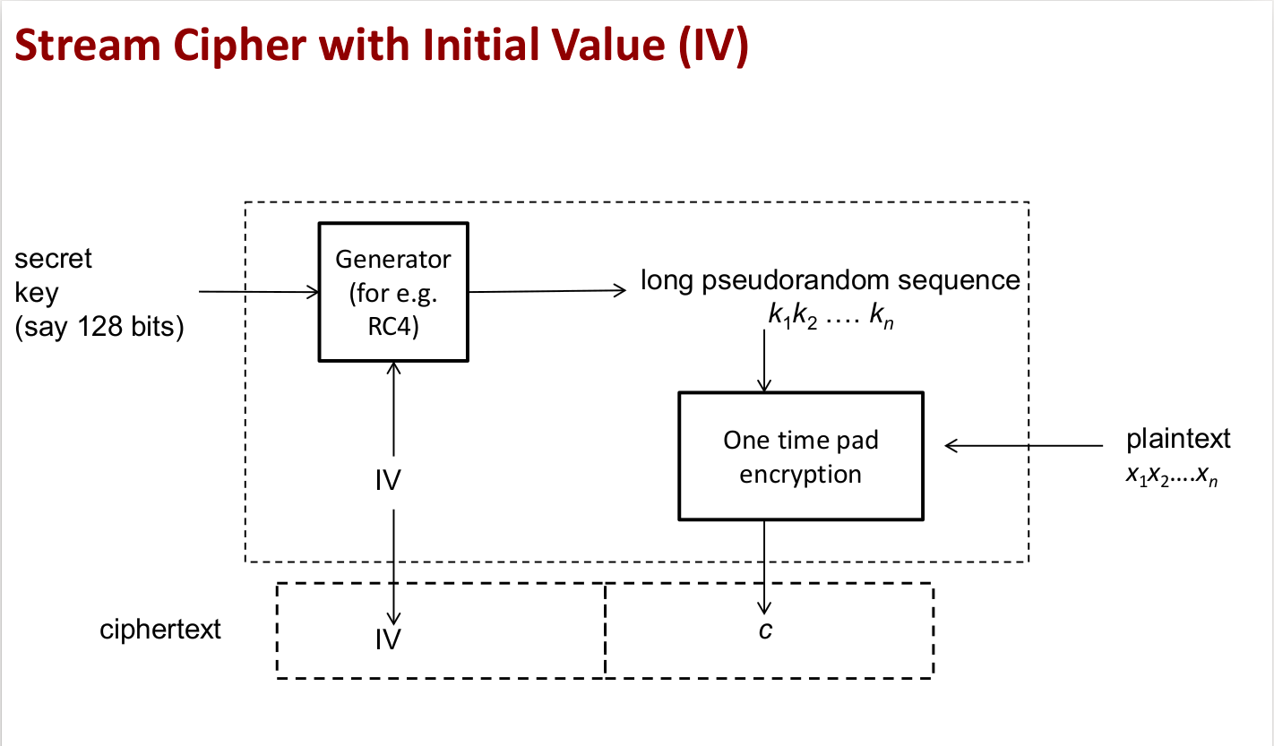
K' (As long as plaintext)
k̃ = k ⊕ IV
(32 bits)
(32 bits)
K' ⊕ X
<-- To find c in realtime

Slide 23

The Attack
"…the first 64 bits of the plaintext are always the string of zeros ..."
I KNOW (part of) THE PLAINTEXT!!
Step 1: Generate the lookup table for all possible keys, k,̃ (2³² entries) and the corresponding 64 bits of encrypted 0's (through stream cipher).
Ie. Construct a table of Enc(000…0) for all possible 2³² values of k̃
Step 2: Take the first 64 bits of ciphertext and check against your table to get k̃
Lookup table takes O(1) time.
Step 3: Use k̃ and IV to generate pseudorandom sequence and to crack the remaining ciphertext
K̃ XOR IV = k
How much additional memory do we need?
=> 2^32 x 8bytes = 32GB

Slide 24
Question 4
Lecture 1 mentioned that Winzip can encrypt a compressed file. Why it is meaningless to carry out the two operations in the other way, that is, first encrypts the file, and then compresses the encrypted file?
(Hint: Consider the effectiveness of compression on “random” sequences, and also a requirement of a good encryption scheme.)

Slide 25
Question 4
Background knowledge:
Compression algorithms make use of repeating patterns to scale down the file
E.g. "101010...10" binary string transform into "10" [repeat 100 times].
Good encryption:
Binaries will resemble a "random" sequence
No repeating patterns
Compress first then encrypt is better
Make full use of repeating patterns in file first to scale down file

Slide 26
Question 5
Bob encrypted a video file using Winzip, which employs the 256-bit key AES. He chose a 6-digit number as password. Winzip generated the 256-bit AES key from the 6-digit password using a hash function, say SHA1.
Alice obtained the ciphertext. Alice also knew that Bob used a 6-digit password. Given a guess of the 256-bit key, Alice could determine whether the key successfully decrypted the file.
How many guesses did Alice really need in order to get the video from the ciphertext encrypted with a 256-bit key in this case?
So 2²⁵⁶ guesses?

Slide 27
Question 5
Encrypted Video
SHA1
256-bits AES key
WinZip
6-digit password
Bob's Video
AES/SHA is deterministic
Same password generates same 256-bits key
Guess all possible 6-digit passwords
10 possibilities per position
10⁶ = 1 million guesses (as compared to 1.16x10^77!!)

Slide 28

Question 6
Google it yourself :P
Keep a cheat sheet with these definitions. They will be tested!

Slide 29

Thank you
Try out the challenge in Luminus forums!

